Slide 2
A first-of-its kind for Texas
A dynamic network of ISDs and a public university partnering to build a brighter future for South Bexar County, enhancing the school-to-college pipeline and providing accessible programs and services for teachers, students and families.
East Central ISD
Edgewood
ISD
Harlandale
ISD
Somerset
ISD
Southwest
ISD
South San Antonio
ISD
Southside
ISD

Slide 3
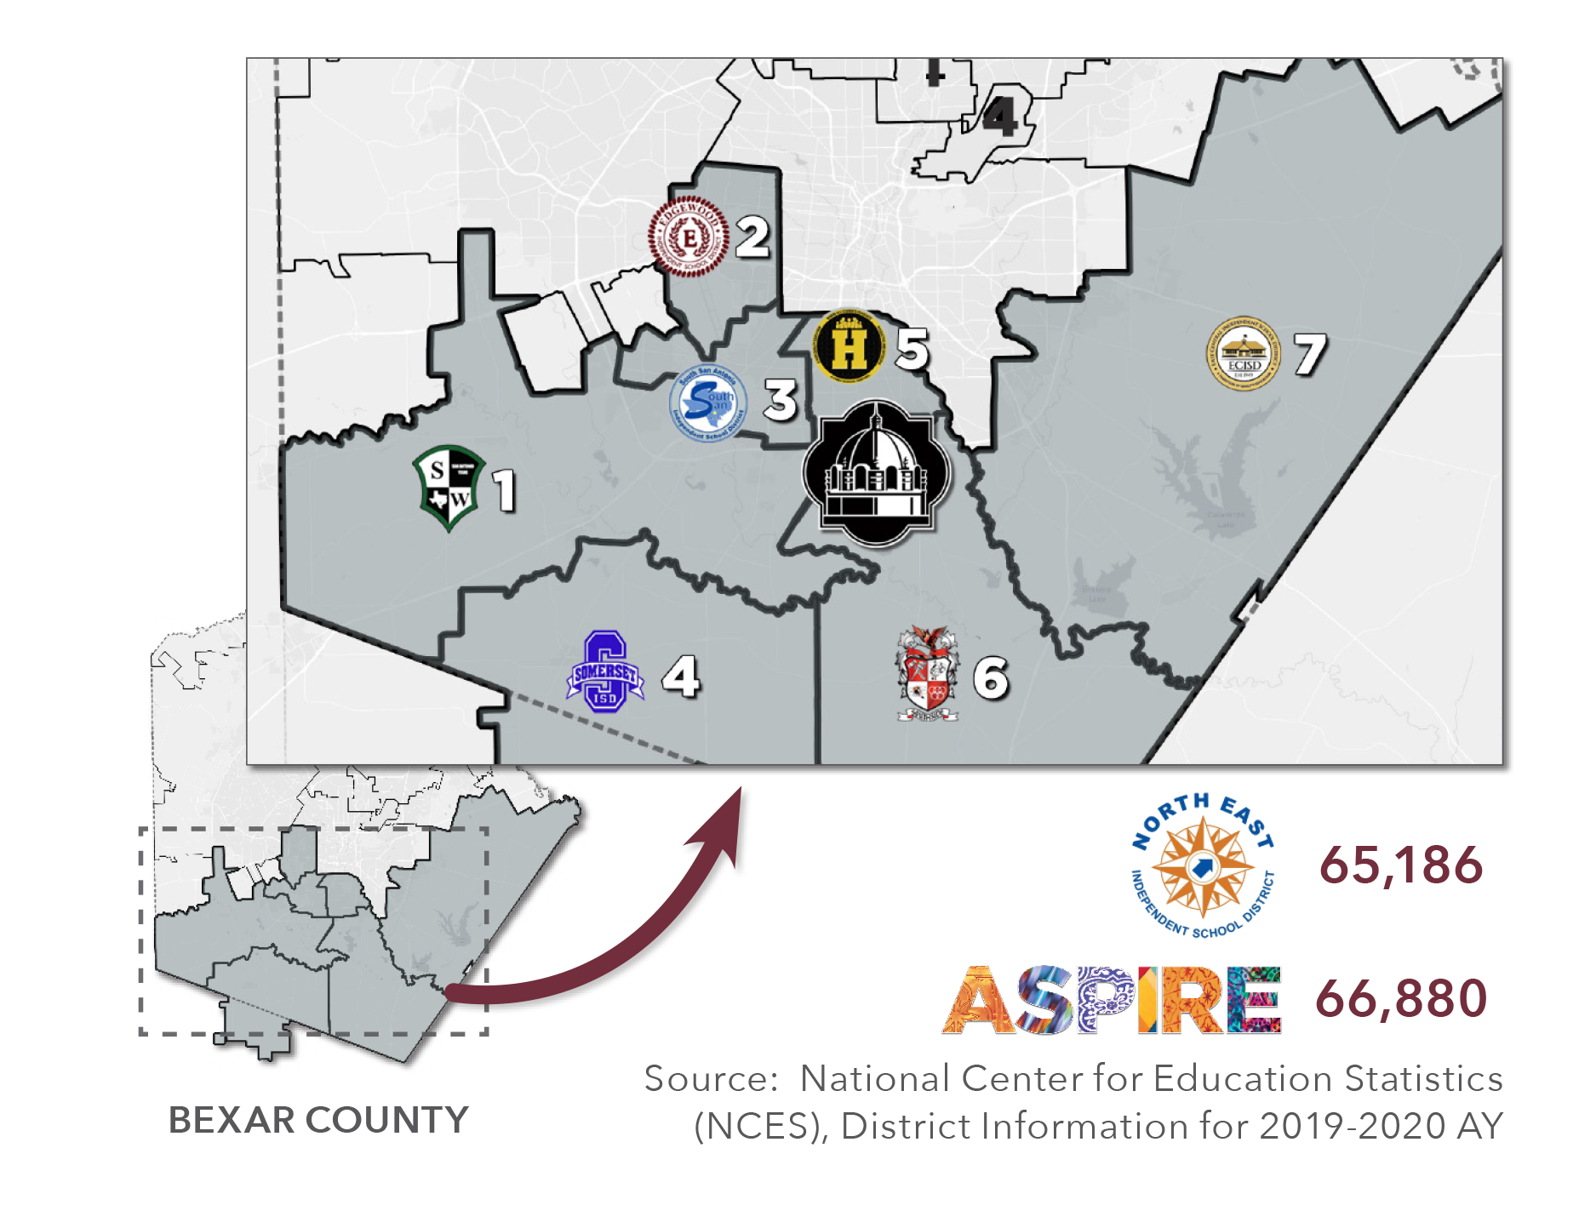

Slide 4
Why ASPIRE Matters
Texas is failing to graduate one out of every five students, which translates to losing 11 students per hour. The statewide attrition rate is 22 percent.
Texas high schools lost 94,767 students in 2017-18.
At this rate, Texas will not reach universal high school education until 2038.
Black and Hispanic students are about twice as likely to leave school without graduating with a diploma than White students.
In the last 33 years, Texas schools have lost a cumulative total of more than 3.8 million students from public high school enrollment prior to graduation.
*Source: IDRA Texas Public School Attrition Study 2017-18

Slide 5
Priorities
Advancing the school-to-college pipeline — four-year degree at A&M-San Antonio.
Educating students and families on the benefits of a four-year degree.
Expanding accessible programs for specialized services for children with special needs across south Bexar County and south San Antonio.
Creating opportunities for a collective impact.
Filling teacher shortages in STEM areas.

Slide 6
Targeted academic programs for high priority areas
“In district” SB1882 Strategy
ISD2A&M-SA Direct Pathway
SAEP Engagement Strategy
Financial Literacy Services & Education
Parent Engagement
K-12 College Bound Programs
College Advisor
Targeted Scholarships
Summer Programs
Early College High School Programs

